Slide 1
Sentiment Analysis of Amazon Cellphone Reviews Team RSS
Rahul Sharma
Shreyesh Doppalapudi
Shivang Suchak

Slide 2
Abstract
Predicting the type of sentiment associated with the reviews provided by the users on a cell phone through Amazon website.
This prediction would be useful for a new user who is trying to look for specific things before buying a new cell phone online by classifying the prominent sentiment of the review.

Slide 3
Context and Problem
Whenever a user tries to find a reliable review before buying a cellphone online, it becomes very confusing as the number of reviews of all phones by famous brands would be very large in number and we get the ambiguous reviews.
It becomes cumbersome to go through each reviews, this model becomes very useful as people can filter out which type and brand of phone they want/do not want to use.
So, we decided to build a model which gives each review a tag based on the sentiments describe in each review and roll it up for the whole brand.

Slide 4
Data Collection and Preparation
Data was collected from kaggle.com containing the Amazon reviews of the cellphone of 10 famous brands.
Link- https://www.kaggle.com/grikomsn/amazon-cell-phones-reviews
The data included labels like Brand, Cellphone Model, Reviews, Rating, Image, URL, etc. with sample size of around 82,000. There were two datasets namely items and reviews
Items data set contained information on brand, item, price for 792 mobile phones while reviews data set contained the reviews associated with these mobile phones

Slide 5
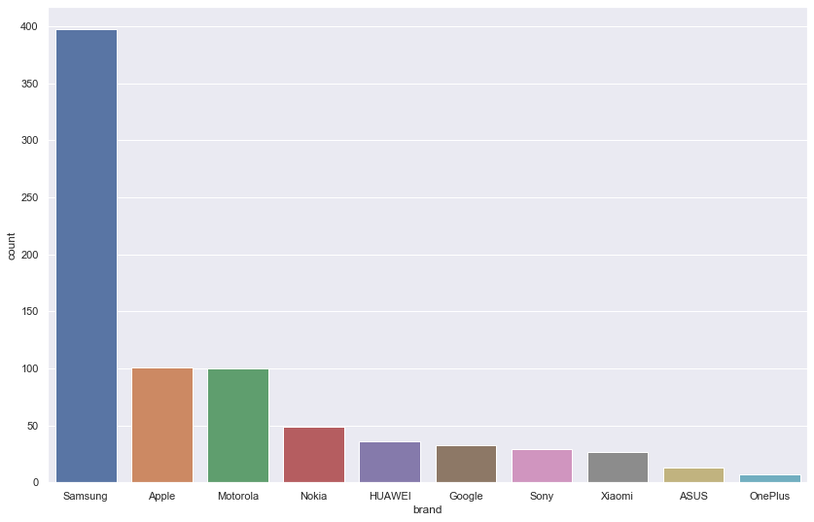
Data Description
Number of Products per Brand

Slide 6
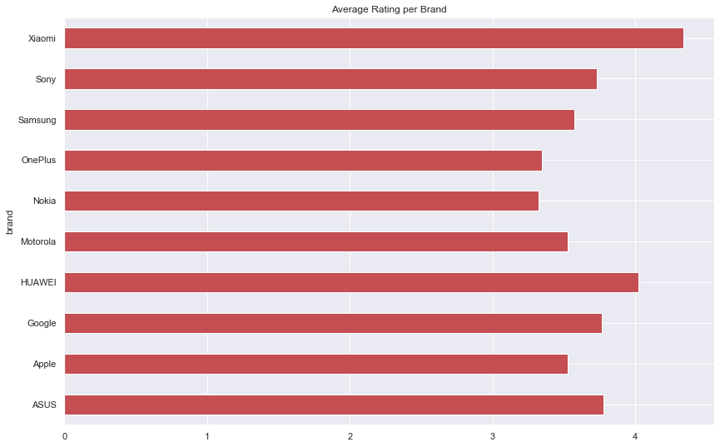
Data Description

Slide 7
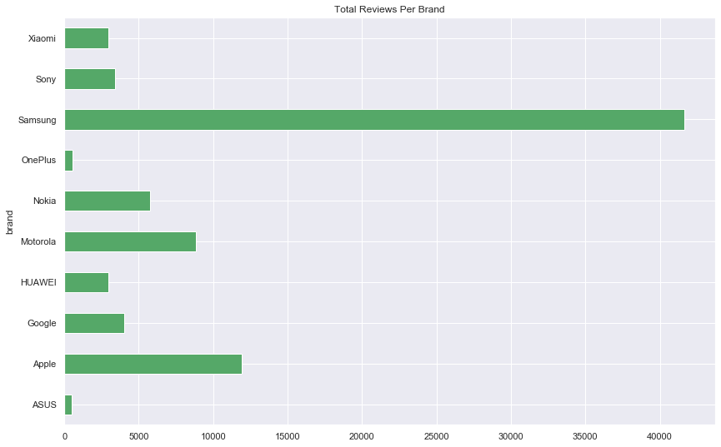
Data Description

Slide 8
Data Cleaning and Preprocessing
We removed values which didn’t make sense for the predictions of the reviews. The attributes dropped are URL, imgURL, reviewUrl, & name
Only verified reviews were filtered from the data set
The body of each review were tokenized and the words were lemmatized to get the root word, removing stop words and punctuation
There were around 100 records in reviews without the review content
All the reviews which has rating > 3 are marked as positive(1), <3 as negative(-1) and =3 as neutral(0).

Slide 9
Methodologies
WordClouds were built for each brand to understand the top words used to describe the positive and negative sentiments for each brand.

Slide 10
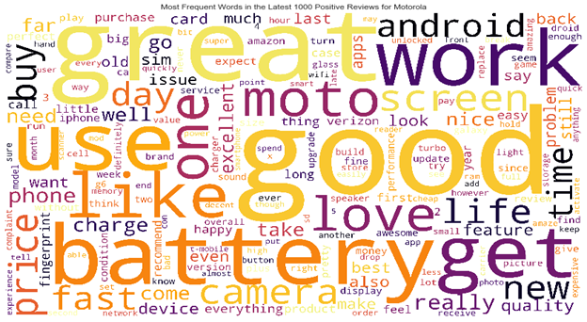
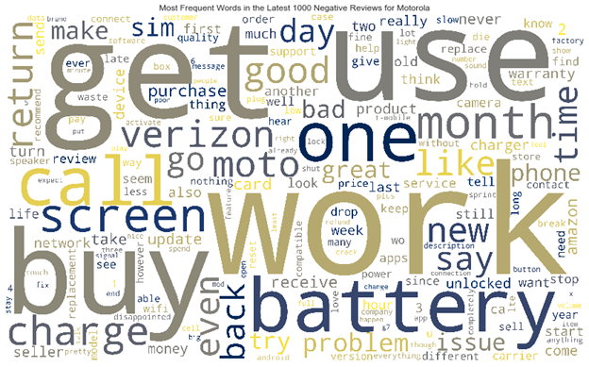
Word Cloud
Top words in Positive Reviews of Brand Motorola
Top words in Negative Revews of Brand Motorola

Slide 11
Methodologies
WordClouds were built for each brand to understand the top words used to describe the positive and negative sentiments for each brand.
Topics were identified from the reviews at a brand level using Non-negative Matrix Factorization (NMF).

Slide 12
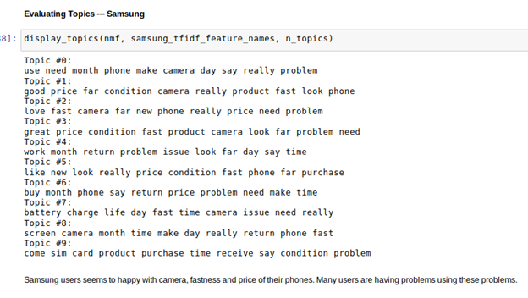
Topic Modelling

Slide 13
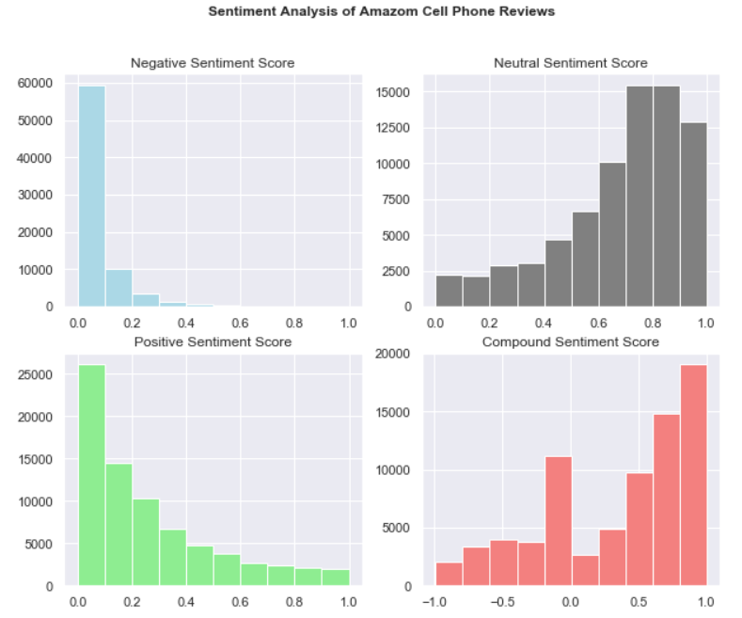
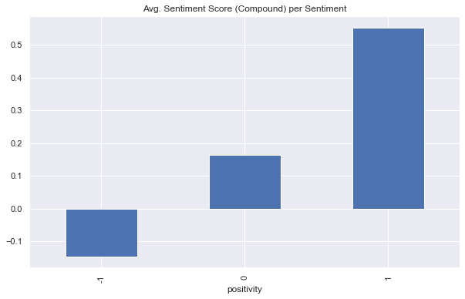
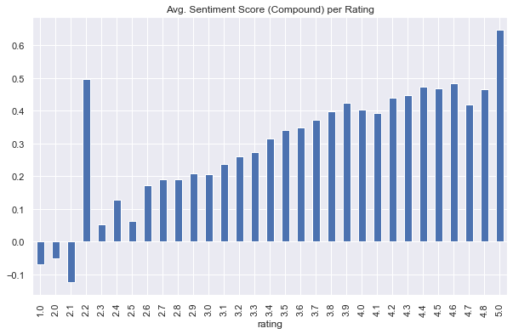
VADER Sentimental Classification
Valence Aware Dictionary and sEntiment Reasoner

Slide 14
Modelling
Two Multinomial Naïve Bayes Classifier models to predict the sentiment and rating of each review.
The complete dataset was split into training and test sets in the ratio of 80:20
The models were trained on the training set and performance was evaluated on test set

Slide 15
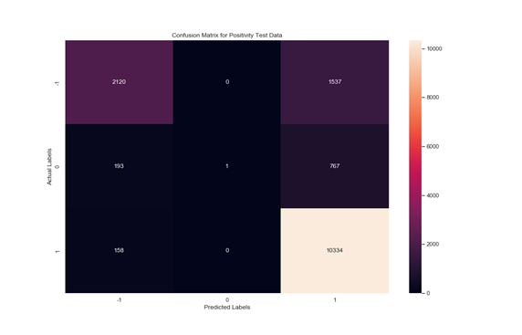
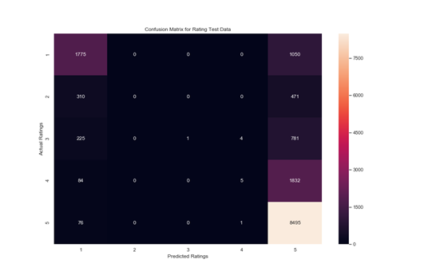
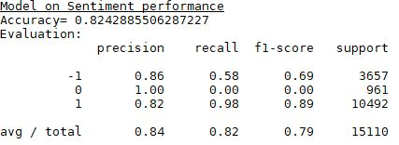
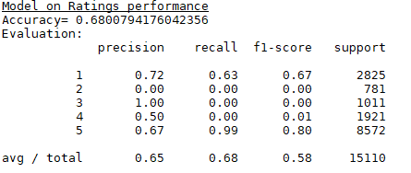
Evaluations – Performance – comparing

Slide 16
Discussion of Results
Both the models performed well in identification of positive sentiments and ratings as evidenced by the high recall for positive sentiment and ratings labels
Both the models performed poorly in identification of intermediate sentiments and rating reducing the precision of the model towards positive and negative sentiments and ratings
Both the models could not leverage the inherent negation in negative reviews, lowering the recall for negative sentiment and ratings labels

Slide 17
Inference/Implication
The identification of inherent negation is an important factor to improve the performance of the model towards negative reviews. Identification of negation and a change of root word to reflect this negation can help in improving the performance of the model
Usage of better Machine Learning Frameworks (such as Deep Learning) can help in idetification of intermediate sentiment and ratings, thereby improving the accuracy of the model

Slide 18
Conclusion
If the performance of the model can be improved, the model can be used to validate the reviews with their corresponding ratings
Such validation can help filter out reviews that are ambigious and help the user with making more informed choice while buying a product
Another possible use case is to identify the top words from the reviews that are segemented by sentiment to show the user the words describing the sentiment

